Slide 1
Unit 1
Concepts of Motion
Sections 1.1-1.2

Slide 2
Motion
The change of an object’s position with time
Four basic types:
  Linear
  Circular Translational Motion
  Projectile
  Rotational
Trajectory:
Path along which an object moves…can be straight or curved!

Slide 3
Translational vs Rotational Motion
Translational motion involves the sliding of an object in one or more of the three dimensions: x, y or z.
  Examples: firing a gun, driving a car
Rotational motion is where an object spins around an internal axis in a continuous way.
  Example: spinning a top

Slide 4
Motion Diagrams
Represents the motion of an object by displaying its location at various equally spaced times on the same diagram.
Give a pictorial description of an object's motion.
  Frames are represented by pictures, showing an object’s position

Slide 5
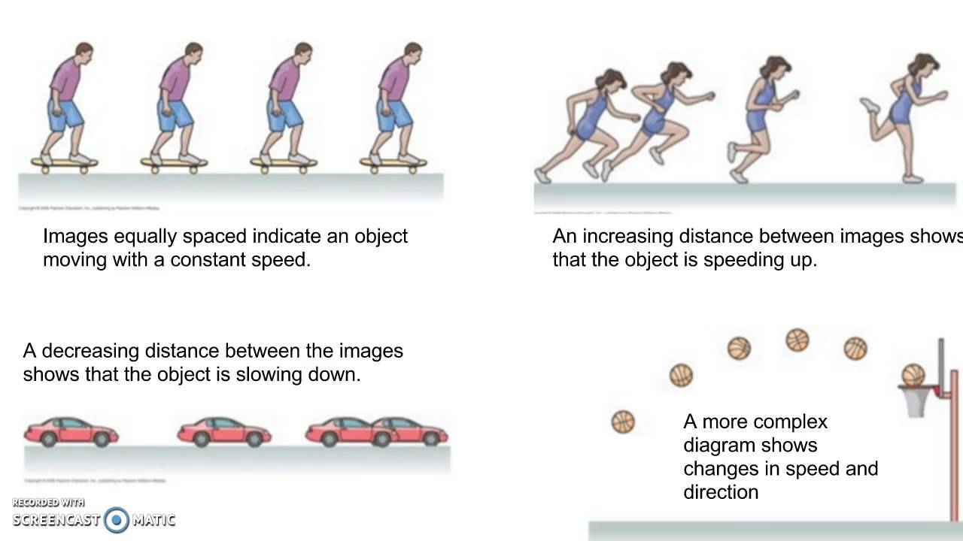
Examples of Motion Diagrams

Slide 6
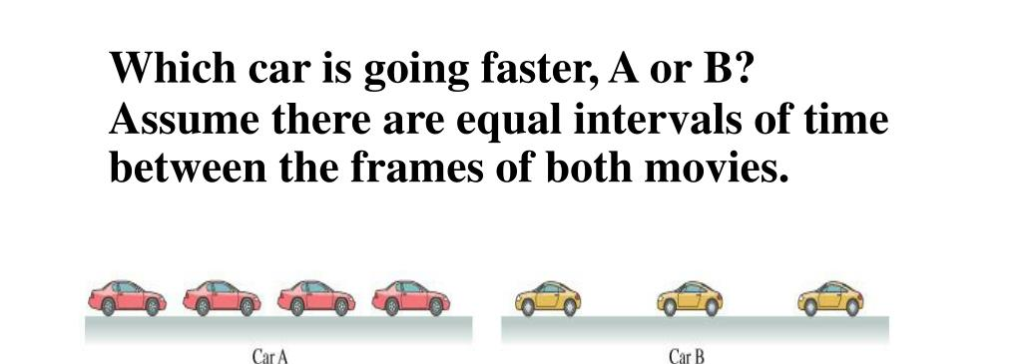
Stop and Think!

Slide 7
The Particle Model
The motion of most objects as a whole is not influenced by its size or shape.
Thus, we can just keep tract of a single point on the object (called a particle)
Dots can replace the use of drawings of the object
  This cannot be used for all objects….those in rotational motion like a gear

Slide 8
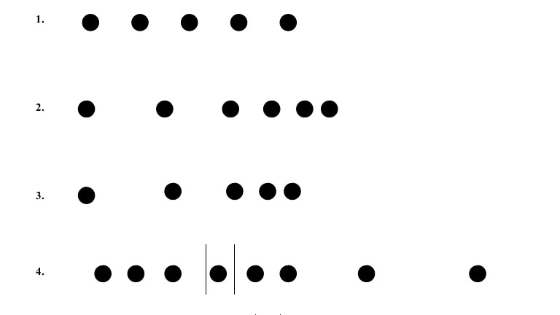
Particle Model Examples

Slide 9
Assignment
Page 29, under Exercises and Problems: 1, 2, 3, 4b, and 4c

Slide 10
Let’s Practice!
We are going in the hall to do examples of motion diagrams in real life.

